Slide 1
FLAPPY BAT GAME VHDL PROJECT
Group Members
Alim Kerem ERDOĞMUŞ - 151220132027
Burak Can FAZLA - 151220144035

Slide 2
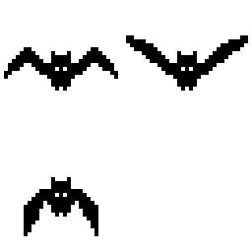
THE PURPOSE OF PROJECT
Flappy Bat is designed as a different version of the game known as Flappy Bird on the market. The flappy bird is replaced by a bat. One-touch gameplay in normal play is arranged as up / down movement in this game.

Slide 3
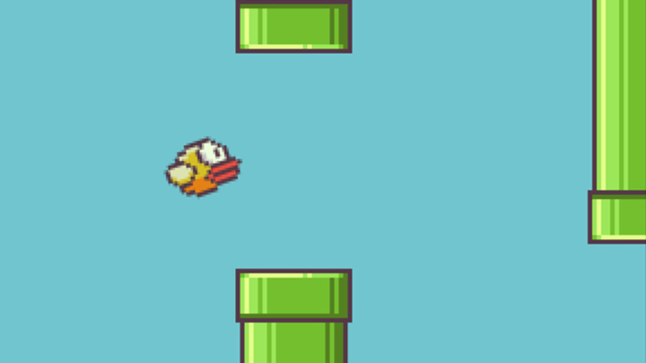
In addition to the overcoming obstacles mission, insects have been added to allow points to be won when defeated. Other game rules are the same as Flappy Bird.

Slide 4
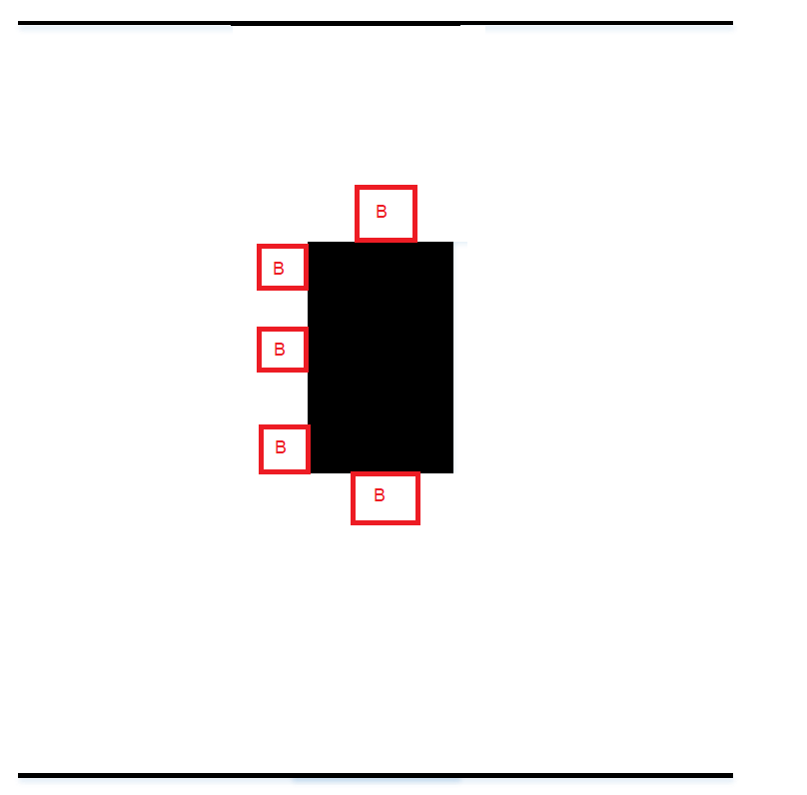
When the obstacles are hit, the game is over and each obstacle passed will earn one point. The obstacles come from right to left, over the bat in random positions, and we are expected to overcome these obstacles with the bat under our control.

Slide 5
The main goal of the game is to earn as high points as you can with these obstacle overcoming and insect eating actions.

Slide 6
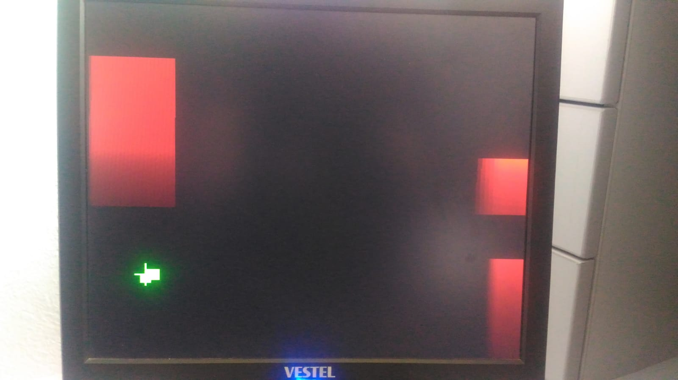
FLAPPY BIRD
FLAPPY BAT

Slide 7
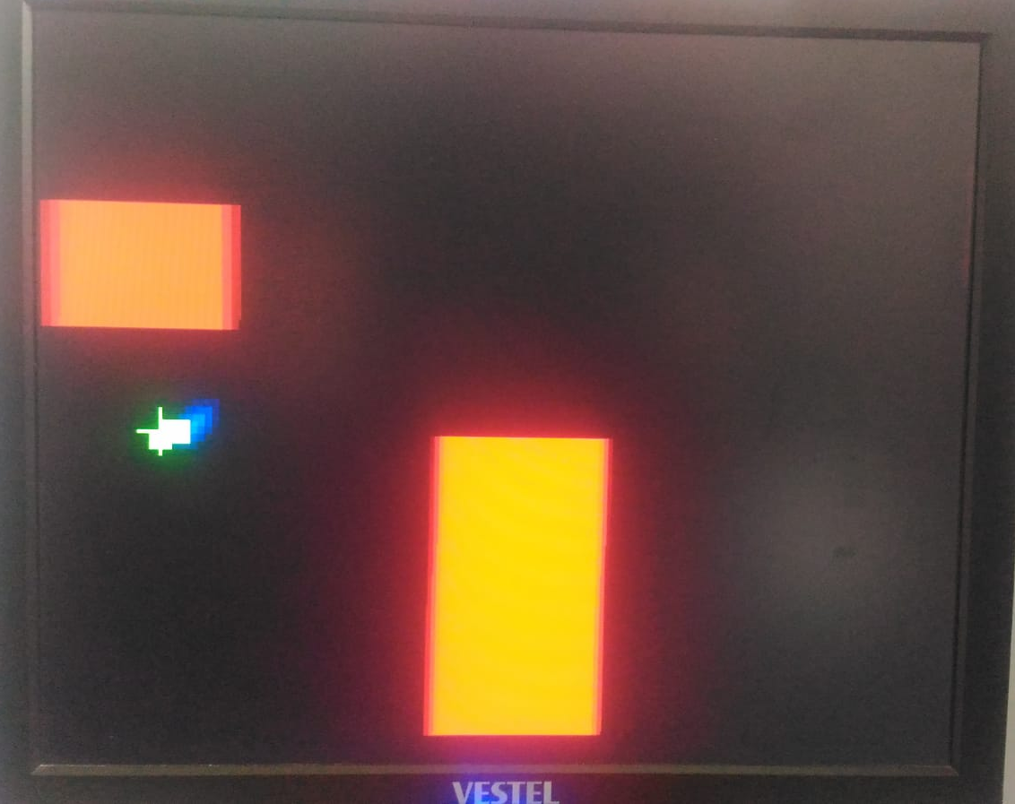
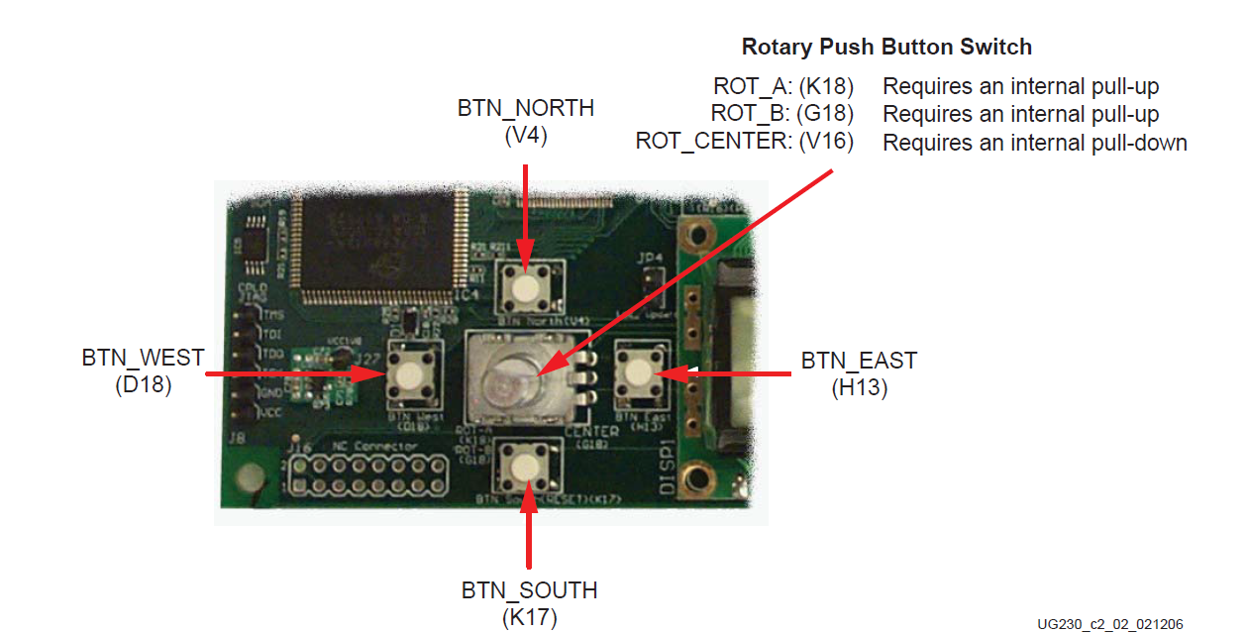
FEATURES OF THE GAME
Two buttons for up and down move of bat.
Bat, boxes and bug will shown on VGA screen.
Movement of boxes and bug.
Crashing event between bat and boxes and between bat and bug.
Showing score with leds.

